Slide 1


Unveiling the Impact: AtliqMart's Promotional Campaign Analysis
Code Basics: Resume Challenge Project #9 (FMCG Domain)

Slide 2
agenda
Introduction
Overview of our study
Questions
Research questions we explored
Dashboards
Tools for data collection and analysis
Findings
Key insights from our study
Conclusion
Implications for professionals.

Slide 3
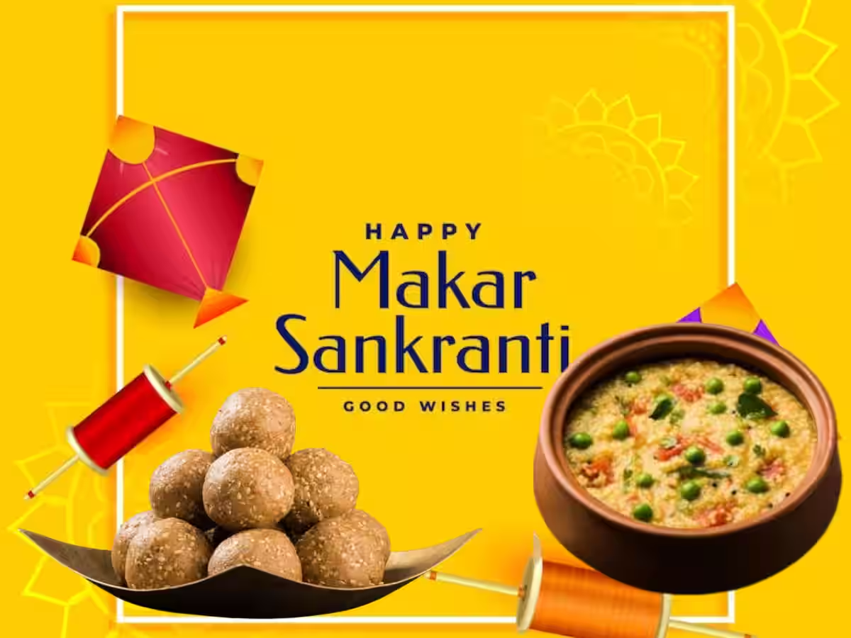
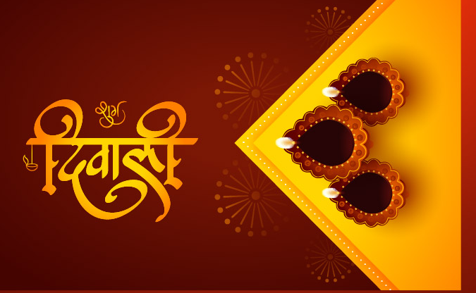
Introduction
Atliq Mart, a prominent retail giant with 50 supermarkets situated in the southern region of India, recently executed a massive promotional campaign during Diwali 2023 and Sankranti 2024. Ascertaining the efficacy of the campaign, the sales director of Atliq Mart is keen on identifying which of the promotions were successful and which ones were not.

Slide 4

Questions
Promotion Type Analysis
Which types of promotion works better in Diwali & Sankranti?
Store Performance Analysis
Highest performing stores in each cities
Product Analysis
highest performing product and category

Slide 5
Dashboard
https://public.tableau.com/views/AtliQMartsInsights/AtliQMart?:language=en-US&:sid=&:display_count=n&:origin=viz_share_link

Slide 6
Tables
Average Revenue Based on Categories
category | promo_type | avg_revenue
Combo1 | 500 Cashback | 1226430
Grocery & Staples | BOGOF | 277316.5
Grocery & Staples | 33% OFF | 78321.06
Grocery & Staples | 25% OFF | -7717.54
Home Appliances | BOGOF | 125752
Home Care | BOGOF | 82174.75
Home Care | 25% OFF | -1738.8
Personal Care | 50% OFF | 2365.41
Personal Care | 25% OFF | -553.5
Change in Revenue Before and After Campaign
campaign_id | campaign_name | revenue_before_campaign | revenue_after_campaign
CAMP_SAN_01 | Sankranti | 58127429 | 140403941
CAMP_DIW_01 | Diwali | 82573759 | 207456209
Incremental Sales unit Percentage and Ranking
category | TQS before promotion | TQS after promotion | Incremental sales unit (%) | Category wise Rank
Home Appliances | 5230 | 18003 | 244.2256 | 1
Combo1 | 16791 | 50769 | 202.3584 | 2
Home Care | 13326 | 23938 | 79.6338 | 3
Personal Care | 16843 | 22074 | 31.0574 | 4
Grocery & Staples | 58129 | 68620 | 18.0478 | 5

Slide 7
Tables
Top 3 and Bottom 3 Products of Atliq Mart
Highest Performing Product in each city
Top 3 and Bottom 3 Stores of Atliq Mart
Least Performing Product in each city

Slide 8
Finding
Grocery and Staples and combo are highest selling categories and Home care is least performing category.
STMYS-1(Mysore) is highest performing store and Atliq Farm Chakki Atta 1kg is highest selling product is this store.
STMLR-0(Mangalore) is least performing store and Atliq Fusion Container Set of 3 is least selling product is this store.
Average revenue increased 1.41 times after Sankranti campaign and 1.52 times after Diwali campaign.

Slide 9
Conclusion
It has come to our attention that Atliq Mart is facing challenges in meeting the expected performance standards in Visakhapatnam. We believe that it is important to address this issue and take the necessary measures to improve the situation.
Our findings indicate that the categories of Home care and Personal care necessitate improvement as certain products within these segments are underperforming. To enhance the quality of products and services, we must identify and address areas that require attention. Our research suggests that this is a critical step toward improving customer satisfaction and loyalty.
The promotional tactic of offering a free item with the purchase of another and providing customers with a cashback of INR 500 has demonstrated a significant increase in revenue, surpassing all other promotional strategies. Notably, stores located in Bangalore, Chennai, and Mysore have exhibited commendable performance across all categories.

Slide 10
Thank you
Name: Sagnik Sanyal
LinkedIn ID: www.linkedin.com/in/sagnik-sanyal-087877195

